Slide 1
Sharky’s Odd Rules
1. When in doubt, wipe the line and re-type it.
11. Never show up late, and empty handed.
3. Never argue with success.
7. Never draw more in the morning than you can erase in the afternoon.

Slide 2
Introduction to Databases and SQL
(Structured Query Language)

Slide 3
WELCOME!
Girl Develop It is here to provide affordable and accessible programs to learn software through mentorship and hands-on instruction.
Some "rules"
We are here for you!
Every question is important
Help each other
Have fun

Slide 4
Introductions
Name
Favorite summer activity

Slide 5
Why Have a Database?
A moving story
Closet
Hangers
Jackets
Shoes

Slide 6
Moving Lists
Rooms
Kitchen
Garage
Family Room
Dining Room
Bedroom
Bathroom
Closet
Patio
Items
Clothes
Jackets
Hangers
Towels
Dishes
Pots & Pans
Utensils
Silverware
Toiletries
Shoes
Books
Games
Lawn Mower

Slide 7
Database Table Rooms
Column
Header
Room
Kitchen
Garage
Family Room
Dining Room
Bedroom
Bathroom
Closet
Patio
Rows

Slide 8
Database Table Items
Column
Header
Item
Clothes
Jackets
Hangers
Towels
Dishes
Pots & Pans
Utensils
Silverware
Toiletries
Shoes
Books
Games
Lawn Mower
Rows

Slide 9

Box Contents
Closet
Hangers
Jackets
Shoes

Slide 10
Database Table Boxes
Columns
Header
Box # | Room | Item 1 | Item 2 | Item 3
1 | Closet | Hangers | Jackets | Shoes
2 | Bathroom | Towels | Toiletries
3 | Kitchen | Towels | Dishes | Silverware
Rows

Slide 11
Database Table Boxes
But wait! Box #3 also has Utensils!
Columns
Header
Box # | Room | Item 1 | Item 2 | Item 3
1 | Closet | Hangers | Jackets | Shoes
2 | Bathroom | Towels | Toiletries
3 | Kitchen | Towels | Dishes | Silverware
Rows

Slide 12
Database Table Boxes
Columns
Header
Box # | Room | Item 1 | Item 2 | Item 3 | Item 4
1 | Closet | Hangers | Jackets | Shoes
2 | Bathroom | Towels | Toiletries
3 | Kitchen | Towels | Dishes | Silverware | Utensils
Rows

Slide 13
Database Table Boxes
Columns
Header
Box # | Room | Item 1 | Item 2 | Item 3 | Item 4
1 | Closet | Hangers | Jackets | Shoes
2 | Bathroom | Towels | Toiletries
3 | Kitchen | Towels | Dishes | Silverware | Utensils
4 | Family Room | Books | Games
Rows

Slide 14
Database Table Boxes
But wait! Box #4 has Books from two rooms!
Columns
Header
Box # | Room | Item 1 | Item 2 | Item 3
1 | Closet | Hangers | Jackets | Shoes
2 | Bathroom | Towels | Toiletries
3 | Kitchen | Towels | Dishes | Silverware
4 | Family Room | Books | Games
Rows

Slide 15
Database Table Boxes
Columns
Box # | Room 1 | Room 2 | Item 1 | Item 2 | Item 3 | Item 4
1 | Closet |  | Hangers | Jackets | Shoes
2 | Bathroom |  | Towels | Toiletries
3 | Kitchen |  | Towels | Dishes | Silverware | Utensils
4 | Family Room | Bedroom | Books | Games

Slide 16

Database Table Boxes
But wait! Box #5 has multiple items
from multiple rooms!
Box # | Room 1 | Room 2 | Item 1 | Item 2 | Item 3 | Item 4
1 | Closet |  | Hangers | Jackets | Shoes
2 | Bathroom |  | Towels | Toiletries
3 | Kitchen |  | Towels | Dishes | Silverware | Utensils
4 | Family Room | Bedroom | Books | Games
5 | Miscellaneous

Slide 17
There Must be a Better Way!
Let’s talk about relationships.
A Box can have:
One item in it (books)
Many items in it (hangers, jackets, shoes)
Likewise a Box can have items from:
One room (kitchen)
Many rooms (family room, bedroom)

Slide 18
Relationships and Cardinality
Relationship
How 2 or more things are connected
Cardinality
The number of things in a set

Slide 19
Cardinality
Cardinality examples
Zero things
One thing
Many things
How many is Many?

Slide 20
Relationships and Cardinality
A Box can have:
One item in it (books)
Many items in it (hangers, jackets, shoes)
Likewise a Box can have items from:
One room (kitchen)
Many rooms (family room, bedroom)

Slide 21
Large Items?
Items that will not be boxed
Patio
Lawn Mower
Family Room
Couch
Chair
Tables
Etc.

Slide 22
Relationships and Cardinality
An Item belongs to One Room
Clothes
An Item may go into One Box, Many Boxes , or No Boxes
Silverware, Shoes, Lawn mower

Slide 23
Empty Boxes?
Do we care about empty boxes?
Yes
We’ll keep them and move them too.
No
We’ll sell them back or trash them.

Slide 24
Zero Cardinality or Optionality
Zero Cardinality (Optionality) examples
An Item may not go in One Box
Lawn mower, couch, table, etc.
A Room may not have anything that goes into a Box
A Box may not have anything in it.

Slide 25

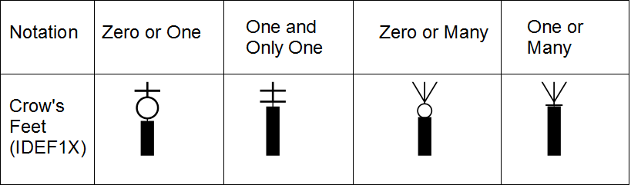
Data Model Notation
Thing A has (is related to) One or More of Thing B
Thing B has (is related to) One and Only One Thing A

Slide 26
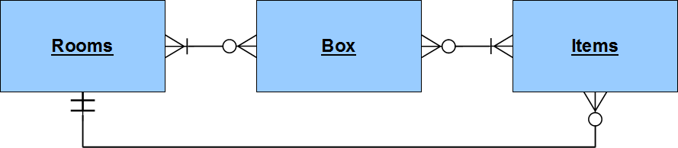
Moving Data Model

Slide 27
Database Table Boxes
Back to our problem
Box | Room 1 | Room 2 | Item 1 | Item 2 | Item 3 | Item 4
1 | Closet |  | Hangers | Jackets | Shoes
2 | Bathroom |  | Towels | Toiletries
3 | Kitchen |  | Towels | Dishes | Silverware | Utensils
4 | Family Room | Bedroom | Books | Games
5 | Miscellaneous

Slide 28
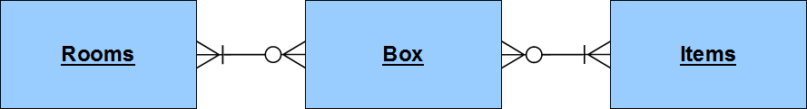
Database Table Boxes
Box | Room 1 | Room 2 | Item 1 | Item 2 | Item 3 | Item 4
1 | Closet |  | Hangers | Jackets | Shoes
2 | Bathroom |  | Towels | Toiletries
3 | Kitchen |  | Towels | Dishes | Silverware | Utensils
4 | Family Room | Bedroom | Books | Games
5 | Miscellaneous

Slide 29
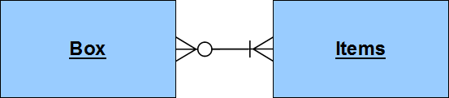
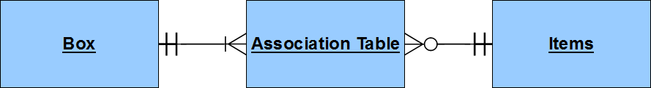
Association Table

Slide 30
Association Table Solution
Box # | Room | Item
1 | Closet | Hangers
1 | Closet | Jackets
1 | Closet | Shoes
2 | Barthroom | Towels
2 | Bathroom | Toiletries
4 | Family Room | Games
4 | Bedroom | Books
5 | Closet | hanger
5 | Closet | Shoes
5 | Garbage | Shoes
5 | Kitchen | Books

Slide 31
But Wait… Typos!
Box # | Room | Item
1 | Closet | Hangers
1 | Closet | Jackets
1 | Closet | Shoes
2 | Barthroom | Towels
2 | Bathroom | Toiletries
4 | Family Room | Games
4 | Bedroom | Books
5 | Closet | hanger
5 | Closet | Shoes
5 | Garbage | Shoes
5 | Kitchen | Books

Slide 32
Database Table Rooms - Updated
Columns
Header
Room ID | Room
1 | Kitchen
2 | Garage
3 | Family Room
4 | Dining Room
5 | Bedroom
6 | Bathroom
7 | Closet
8 | Patio
Rows

Slide 33
Database Table Items - Updated
Columns
Header
Item ID | Item
1 | Clothes
2 | Jackets
3 | Hangers
4 | Towels
5 | Dishes
6 | Pots & Pans
7 | Utensils
8 | Silverware
9 | Toiletries
10 | Shoes
11 | Books
12 | Games
13 | Lawn Mower
Rows

Slide 34
Association Table - Updated
No Typos!
Box | Room ID | Item ID
1 | 7 | 3
1 | 7 | 2
1 | 7 | 10
2 | 6 | 4
2 | 6 | 9
4 | 3 | 12
4 | 5 | 11
5 | 7 | 3
5 | 7 | 10
5 | 2 | 10
5 | 1 | 11
But what’s in the Box?

Slide 35
Enter SQL!
SQL in the sequel
Break Time!

Slide 36
Sharky’s Odd Rules Continued
5. On Friday, visit other teams, they may have donuts.
13. It’s 5 o’clock somewhere.
15. Just do the copy-paste.
19. If it works on the first try be suspicious.

Slide 37
SQL Statements
SELECT – Retrieve (SELECT) data from a table.
INSERT – Add (INSERT) data into a table.
DELETE – Remove (DELETE) data from a table.
CREATE – Add (CREATE) a table, or other object.
DROP – Remove (DROP) a table, or other object.
EXEC – Run (EXECUTE) a Stored Procedure.

Slide 38
Anatomy of a SELECT Statement
SELECT
<column,…>
FROM <table>
WHERE <condition>
ORDER BY <column,…>

Slide 39
Anatomy of a SELECT Statement
SELECT
<column,…>
A list of columns or just use * for all columns
SELECT
*
Get all columns
SELECT
Name, Zip, Phone
Get only 3 columns

Slide 40
Anatomy of a SELECT Statement
FROM <table>
Name of a table
FROM Rooms
Rooms table
FROM Items
Items table
FROM Boxes
Boxes table

Slide 41
Anatomy of a SELECT Statement
WHERE <condition>
Criteria or filter conditions
WHERE Item = ’Books’
Only get rows where the Item is Books
WHERE ItemID >= 4
Only get rows where the value of the Item ID is greater than or equal to

Slide 42
Anatomy of a SELECT Statement
ORDER BY <column,…>
Sort by a column or columns,
Ascending (ASC) is the default,
descending (DESC) is an option.
ORDER BY Item
Sort by the Item
(ascending)
ORDER BY ItemID DESC
Sort by the ItemID
descending

Slide 43
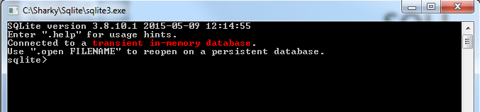
Time to Play!
Open sqlite3

Slide 44
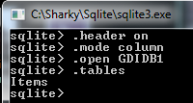
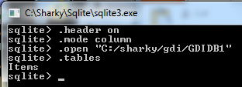
Sqlite housekeeping
sqlite> .header on
sqlite> .mode column
sqlite> .open GDIDB1
sqlite> .tables
To use full path - use ‘/’ and must be in quotes!
.open “C:/sharky/gdi/GDIDB1”

Slide 45
Basic SELECT Statement
SELECT
<column,…> (use * for all columns)
FROM <table>

Slide 46
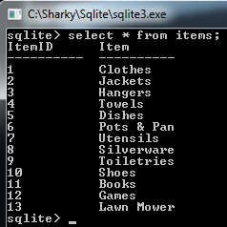
SQL!
Single line
sqlite> SELECT * FROM Items;
Multi-line
sqlite> SELECT *
…> FROM Items
…> ;

Slide 47
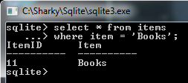
SQL Where Clause
sqlite> SELECT * FROM Items
…> WHERE Item = ‘books’;

Slide 48
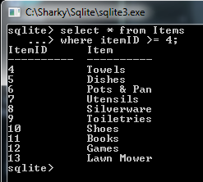
SQL Where Clause
sqlite> SELECT * FROM Items
…> WHERE ItemID >= 4;

Slide 49
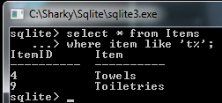
SQL Where Clause
sqlite> SELECT * FROM Items
…> WHERE Item like ‘t%’;
% is a wildcard
‘t%’ – starts with ‘t’
‘%t’ – ends with ‘t’
‘%t% - has a ‘t’
somewhere

Slide 50
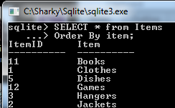
SQL Order By Clause
sqlite> SELECT * FROM Items
…> Order By item;

Slide 51
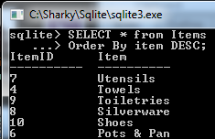
SQL Order By Clause
sqlite> SELECT * FROM Items
…> Order By item DESC;

Slide 52
Multiple Related Tables
Box | Room ID | Item ID
1 | 7 | 3
1 | 7 | 2
1 | 7 | 10
2 | 6 | 4
2 | 6 | 9
4 | 3 | 12
4 | 5 | 11
5 | 7 | 3
5 | 7 | 10
5 | 2 | 10
5 | 1 | 11
Room ID | Room
1 | Kitchen
2 | Garage
3 | Family Room
4 | Dining Room
5 | Bedroom
6 | Bathroom
7 | Closet
8 | Patio
Item ID | Item
1 | Clothes
2 | Jackets
3 | Hangers
4 | Towels
5 | Dishes
6 | Pots & Pans
7 | Utensils
8 | Silverware
9 | Toiletries
10 | Shoes
11 | Books
12 | Games
13 | Lawn Mower

Slide 53
Anatomy of a SELECT JOIN Statement
SELECT
<column,…>
FROM <table1>
JOIN <table2>
ON <table1.column> = <table2.column>
…
WHERE <condition>
ORDER BY <column,…>

Slide 54
Multiple Related Tables = SQL JOIN
Box | Room ID | Item ID
1 | 7 | 3
1 | 7 | 2
1 | 7 | 10
2 | 6 | 4
2 | 6 | 9
4 | 3 | 12
4 | 5 | 11
5 | 7 | 3
5 | 7 | 10
5 | 2 | 10
5 | 1 | 11
Room ID | Room
1 | Kitchen
2 | Garage
3 | Family Room
4 | Dining Room
5 | Bedroom
6 | Bathroom
7 | Closet
8 | Patio
Item ID | Item
1 | Clothes
2 | Jackets
3 | Hangers
4 | Towels
5 | Dishes
6 | Pots & Pans
7 | Utensils
8 | Silverware
9 | Toiletries
10 | Shoes
11 | Books
12 | Games
13 | Lawn Mower

Slide 55


Sqlite housekeeping
sqlite> .open <path>GDIDB3
sqlite> .tables
To use full path - use ‘/’ and must be in quotes!
.open “C:/sharky/gdi/GDIDB3”

Slide 56
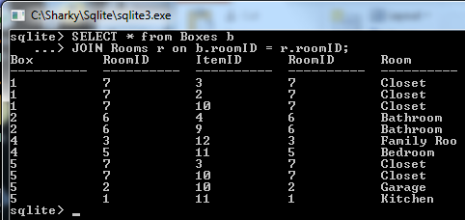
SQL JOIN Clause
sqlite> SELECT * FROM Boxes b
…> JOIN Rooms r ON b.roomID = r.roomID;

Slide 57
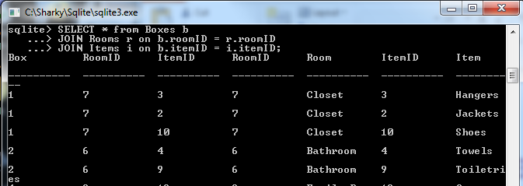
SQL JOIN Clause
sqlite> SELECT * FROM Boxes b
…> JOIN Rooms r ON b.roomID = r.roomID
…> JOIN Items i ON b.itemID = i.itemID;

Slide 58
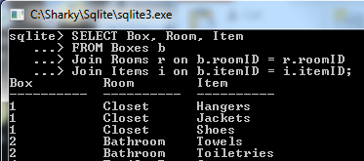
SQL JOIN Clause
sqlite> SELECT Box, Room, Item
…> FROM Boxes b
…> JOIN Rooms r ON b.roomID = r.roomID
…> JOIN Items i ON b.itemID = i.itemID;

Slide 59
Anatomy of a CREATE TABLE Statement
CREATE TABLE <table name> (
<column name> <data type> <constraint>,
…
);

Slide 60
Sqlite housekeeping
sqlite> .open GDIDB1
sqlite> .tables
To use full path - use ‘/’ and must be in quotes!
.open “C:/sharky/gdi/GDIDB1”

Slide 61
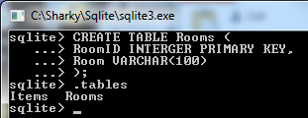
CREATE TABLE Statement
sqlite> CREATE TABLE Rooms (
…> RoomID INTEGER PRIMARY KEY,
…> Room VARCHAR(100)
…> );

Slide 62
Anatomy of an INSERT Statement
INSERT INTO <table name> (column,…)
VALUES (values,…);
Data for a single row only

Slide 63
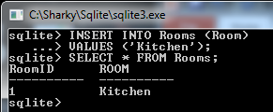
INSERT Statement
sqlite> INSERT INTO Rooms (Room)
…> VALUES (‘Kitchen’);
sqlite> SELECT * FROM Rooms;

Slide 64
SQL Statements
SELECT – Retrieve (SELECT) data from a table.
INSERT – Add (INSERT) data into a table.
DELETE – Remove (DELETE) data from a table.
CREATE – Add (CREATE) a table, or other object.
DROP – Remove (DROP) a table, or other object.
EXEC – Run (EXECUTE) a Stored Procedure.

Slide 65


Slide 66


